Slide 1
CONTINUA MECHANICS
foundations of continuum dynamics:
forces and stresses

Slide 2
Forces and Force Fields in Continuum Mechanics
δm a(x, t) δm = ρ(x, t) dV
→
→
→
1. Body forces act throughout the volume dV of the particle in question.
2. Contact forces act on the boundary surface dS of the particle in question.
Stable
Regular
Representative
→
→
→
→
→
→
F = g + R + a_{(inertia)} = g′ + R , (g′ = g + a_{(inertia)}
→
→
→
→
→
→
→
→
→
g - gravitational force
R – electromagnetic (ponderomotive) force
→
→

Slide 3
Surface contact forces and traction vector
Contact forces (INTERNAL FORCES) arise from atomic-scale or intermolecular interactions and weaken over distances on the order of intermolecular separation
l_{mol} << dx << L
Compressibility,
Elasticity,
Viscosity,
Plasticity,
Material strength.

Slide 4
n is the outward unit normal to an infinitesimal surface of area dS
→
δP
δS
n
→
→
→
→
M
δr₂
→
δr₁
δr₁ ∼ δr₂∼ δr
∼ l_{microt}
Δ_{min}
Δ_{max}
∼ L
δr
1. l_{micro}<< Δ_{min}< δr < Δ_{max}<< L − Plateau or Stability
→
→
→
→
2. Regular
3. Representative
→
→
→
→

Slide 5
→
→
→
→
a continuous field is an approximate model of contact forces that is applicable on scales far exceeding intermolecular separations and constituent particle sizes.
dP(n)
Newton's third law –
- action equals reaction
→
→
dS(n)
n
→
→
dP(n) = – dP(–n)
→
→
→
→
M
M
dS(–n)
–n
→
→
→
→
→
→
→
→
→
dP(–n)
→
Odd function of unit normal n.
→

Slide 6
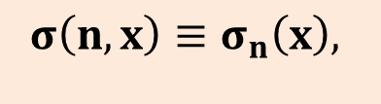
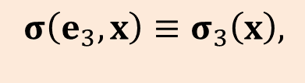
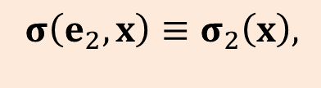

Stress Tensor
x₃
A₃
Arbitrary tetrahedron
σ(– e₁)
→
→
σ(– e₂)
→
→
n
– e₁
→
→
– e₂
σ(n)
→
→
→
x₂
M
A₂
→
→
→
→
→
→
A₁
– e₃
→
σ(– e₃)
→
→
→
→
→
→
(i =1, 2, 3).
x₁
→
→
→
→
→
→
(i =1, 2, 3).
$$σ\left(e_{1},x\right)≡σ_{1}\left(x\right),$$
$$σ\left(e_{2},x\right)≡σ_{2}\left(x\right),$$
$$σ\left(e_{3},x\right)≡σ_{3}\left(x\right),$$
$$σ\left(n,x\right)≡σ_{n}\left(x\right),$$
→
→
→
→
→
→
→
→
→
→
→
→
→
→
→
→
→
→
→
→

Slide 7
Newton’s second law
Ф ≡ ρ(F – a)
Mean Value Theorem
$σ\left(e_{i}, x\right)≡σ_{i}\left(x\right), σ\left(n, x\right)≡σ_{n}\left(x\right)$ (i = 1, 2, 3)

Slide 9
h → 0, n = n_{i}e_{i} = const

Slide 10
Equilibrium Equation of Surface Forces at the point
x₃
σ_{3n}
e₃
σ_{n}
n
σ_{2n}
e₂
x₂
e₁
σ_{1n}
x₁
New Cartesian coordinates with

Slide 11
Theorem
The components σ_{ij} of the tractions constitute a second-rank tensor
S = σ_{ij} e_{i}e_{j}.
Definition
The second-rank tensor
S = σ_{ij} e_{i}e_{j}.
whose components σ_{ij} are those of the tractions (stresses) is referred to as the stress tensor.

Slide 12
σ₃₃
x₃
e₃
- σ₁₁
A₃
S₋₁
σ₂₃
B₁
σ₁₃
B₂
S₃
- e₁
C
σ₃₂
- σ₂₁
- e₂
- σ₁₂
σ₃₁
- σ₃₁
- σ₂₂
e₂
σ₂₂
e₁
σ₁₂
σ₂₁
- σ₃₂
M
x₂
- σ₁₃
A₂
S₋₂
- σ₂₃
S₂
A₁
S₋₃
S₁
x₁
- e₃
B₃
σ₁₁
- σ₃₃
σ₁₁, σ₂₂, σ₃₃ - normal (compressive or tensile) stresses
σ₁₂, σ₁₃, σ₂₁, σ₂₃, σ₃₁, σ₃₂ - are tangential (shear) stresses

Slide 13
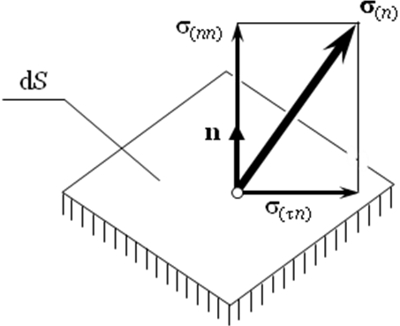
n

Slide 14




$$σ_{n}$$
$$σ_{n}$$
$$σ_{nn}$$
$$n$$
S

Slide 15
σ₃₃
Balance of Linear Momentum
x₃
e₃
- σ₁₁
A₃
S₋₁
σ₂₃
B₁
σ₁₃
B₂
S₃
- e₁
C
σ₃₂
- σ₂₁
- e₂
- σ₁₂
σ₃₁
- σ₃₁
- σ₂₂
e₂
σ₂₂
e₁
σ₁₂
σ₂₁
- σ₃₂
M
x₂
- σ₁₃
A₂
S₋₂
- σ₂₃
S₂
A₁
S₋₃
S₁
x₁
- e₃
B₃
σ₁₁
- σ₃₃

Slide 20
M is an arbitrary point,

Slide 21
Balance of Angular Momentum

Slide 22
σ₃₃
x₃
e₃
- σ₁₁
A₃
S₋₁
σ₂₃
B₁
σ₁₃
B₂
S₃
- e₁
C
σ₃₂
- σ₂₁
- e₂
- σ₁₂
σ₃₁
- σ₃₁
- σ₂₂
e₂
σ₂₂
e₁
σ₁₂
σ₂₁
- σ₃₂
M
x₂
- σ₁₃
A₂
S₋₂
- σ₂₃
S₂
A₁
S₋₃
S₁
x₁
- e₃
B₃
σ₁₁
- σ₃₃

Slide 23
σ₃₃
x₃
e₃
- σ₁₁
A₃
S₋₁
σ₂₃
B₁
σ₁₃
B₂
S₃
- e₁
C
σ₃₂
- σ₂₁
- e₂
- σ₁₂
σ₃₁
- σ₃₁
- σ₂₂
e₂
σ₂₂
e₁
σ₁₂
σ₂₁
- σ₃₂
M
x₂
- σ₁₃
A₂
S₋₂
- σ₂₃
S₂
A₁
S₋₃
S₁
x₁
- e₃
B₃
σ₁₁
- σ₃₃

Slide 24
σ₃₃
x₃
e₃
- σ₁₁
A₃
S₋₁
σ₂₃
B₁
σ₁₃
B₂
S₃
- e₁
C
σ₃₂
- σ₂₁
- e₂
- σ₁₂
σ₃₁
- σ₃₁
- σ₂₂
e₂
σ₂₂
e₁
σ₁₂
σ₂₁
- σ₃₂
M
x₂
- σ₁₃
A₂
S₋₂
- σ₂₃
S₂
A₁
S₋₃
S₁
x₁
- e₃
B₃
σ₁₁
- σ₃₃

Slide 25
M is an arbitrary point,

Slide 26
Note:
Stress tensor symmetry follows from the moment balance written, which contains contributions from body forces and contact stresses only.
Note:
In certain structured continua known as micropolar media, angular momentum contains a contribution from intrinsic spin proportional to the control volume or h³.
An additional contribution can arise from distributed surface couples.
These effects can break the symmetry of the stress and should be analyzed separately.

Slide 27
M
(b)
Theorem 1. For the stress tensor at arbitrary point M, there exist three mutually orthogonal principal planes (with normal vectors along the principal directions of stress) on which stresses are strictly normal
Convention on order of numbers:

Slide 28
Definitions.
A state of stress in which none of the three principal stresses vanishes ( ≠ 0, i = 1, 2, 3) is said to be triaxial:
When one—and only one—principal stress vanishes, the state of stress is referred to as plane or biaxial:
When two principal stresses vanish, the state of stress is called uniaxial:

Slide 29
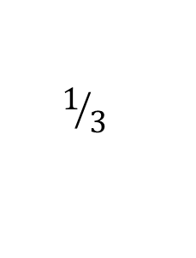
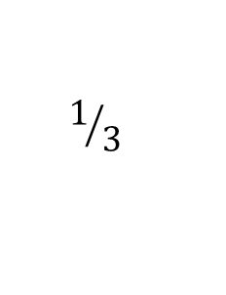
σ_{n}
σ_{nn}
Arbitrary plane with unit normal
δS
n
σ_{nτ}
M
σ_{ij} = – pδ_{ij} + τ_{ij} , p = – (σ₁₁ + σ₂₂ + σ₃₃) = – σ_{kk} - invariant pressure
$$1/3$$
$$1/3$$

Slide 30
σ_{nn} and σ_{nτ} are even functions of
.
S₃
T₂₃
S₂
T₁₃
T₁₂
S₁

Slide 31
S₃
P₂₃
S₂
S₂
P₃₂
S₃
S₁
P₂₁
S₃
P₁₃
P₁₂
P₁₂
T₁₂
T₁₃
T₂₃
S₁
S₁
S₂
Extremum values of normal and shear stresses
Principal Directions

Slide 32


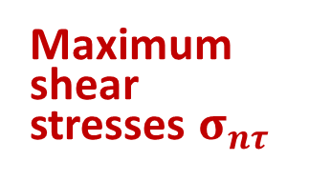

Principal shear directions, and principal shear stresses.
Maximum shear stresses $σ_{nτ}$
$${\text{T}}_{23}$$
$${\text{T}}_{13}$$
$${\text{T}}_{12}$$

Slide 33
Mohr diagram
σ_{τn}
T₁₃
T₁₂
T₂₃
S₂
S₃
S₁
σ_{nn}
C₂₃
C₁₃
C₁₂

Slide 34
Material Time Derivatives of the Stress Tensor
For function ϕ(x, t):
dϕ = (∇_{i}ϕ) dx_{i} + dt = ϕ(x + dx, t + dt) – ϕ(x, t) + o(dx, dt).
dx = v dt, dx_{i} = v_{i}dt

Slide 35
$$σn = σn\left(n, x, t\right)$$
Δx = v Δt, Δn = [ω×n ] Δ t,
Δx_{i} = v_{i} Δt,
Δn_{i} = ε_{ijk}ω_{j}n_{k} Δt = ε_{ijk} ω_{j}n_{k} Δt

Slide 36
Δx = v Δt, Δn = [ω×n ] Δ t,
Δx_{i} = v_{i} Δt,
Δn_{i} = ε_{ijk}ω_{j}n_{k} Δt = ε_{ijk} ω_{j}n_{k} Δt = ε_{ijk} (¹/₂ rot v)_{j} n_{k} Δt = ¹/₂ Δt n_{k} ε_{ijk} ε_{jlm}∇_{l} v_{m}
= ¹/₂ Δt n_{k} ε_{jki} ε_{jlm}∇_{l} v_{m} = ¹/₂ Δt n_{k} (δ_{kl} δ_{im} − δ_{km} δ_{il} )∇_{l} v_{m} =
= ¹/₂ Δt n_{k} (δ_{kl} δ_{im}∇_{l} v_{m} − δ_{km} δ_{il} ∇_{l} v_{m} ) = Δt n_{k} (∇_{k} v_{i} − ∇_{i}v_{k} ) ¹/₂ =
= Δt n_{k} ω_{ik}

Slide 38
dx = v dt (dx_{i} = v_{i} dt)
dn = [ω×n ] dt (dn_{i} = dt n_{k} ω_{ik})
dμ = [ω×n ] dt (dμ_{i} = dt μ_{k} ω_{ik})
n and μ move and rotate as rigid body (v and ω)

Slide 39
Let
Then
- Yaumann Derivative

